Slide 1
Chapter 9: Differential Analysis of Fluid Flow
Chao-Lung Ting
Department of Engineering Science and Ocean Engineering
National Taiwan University
Fall 2014

Slide 2
Objectives
Understand how the differential equations of mass and momentum conservation are derived.
Calculate the stream function and pressure field, and plot streamlines for a known velocity field.
Obtain analytical solutions of the equations of motion for simple flows.

Slide 3
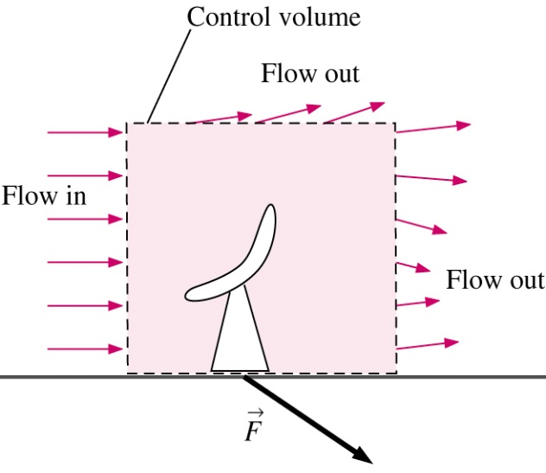
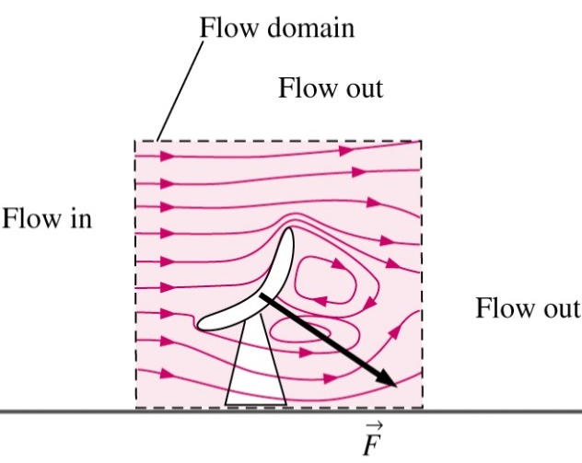
Introduction
Recall
  Chap 5: Control volume (CV) versions of the laws of conservation of mass and energy
  Chap 6: CV version of the conservation of momentum
CV, or integral, forms of equations are useful for determining overall effects
However, we cannot obtain detailed knowledge about the flow field inside the CV ⇒ motivation for differential analysis

Slide 4

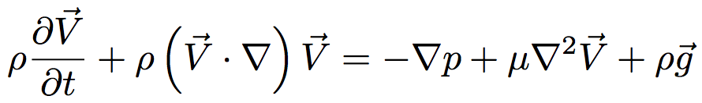
Introduction
Example: incompressible Navier-Stokes equations
We will learn:
  Physical meaning of each term
  How to derive
  How to solve

Slide 5
Introduction
For example, how to solve?
Step | Analytical Fluid Dynamics (Chapter 9) | Computational Fluid Dynamics (Chapter 15)
1 | Setup Problem and geometry, identify all dimensions and parameters
2 | List all assumptions, approximations, simplifications, boundary conditions
3 | Simplify PDE’s | Build grid / discretize PDE’s
4 | Integrate equations | Solve algebraic system of equations including I.C.’s and B.C’s
5 | Apply I.C.’s and B.C.’s to solve for constants of integration
6 | Verify and plot results | Verify and plot results

Slide 6
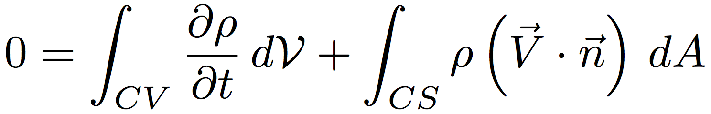
Conservation of Mass
Recall CV form (Chap 5) from Reynolds Transport Theorem (RTT)
We’ll examine two methods to derive differential form of conservation of mass
  Divergence (Gauss’s) Theorem
  Differential CV and Taylor series expansions

Slide 7
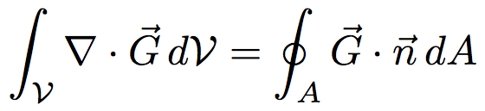
Conservation of Mass
Divergence Theorem
Divergence theorem allows us to transform a volume integral of the divergence of a vector into an area integral over the surface that defines the volume.

Slide 8
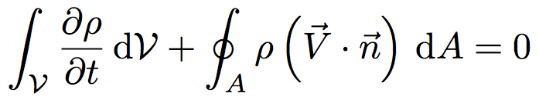
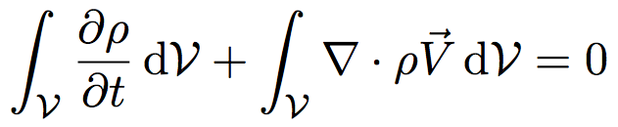
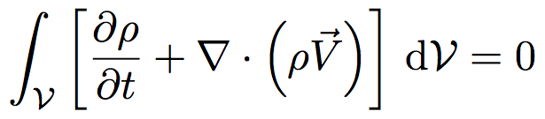
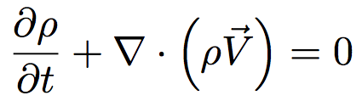
Conservation of Mass
Divergence Theorem
Rewrite conservation of mass
Using divergence theorem, replace area integral with volume integral and collect terms
Integral holds for ANY CV, therefore:

Slide 9
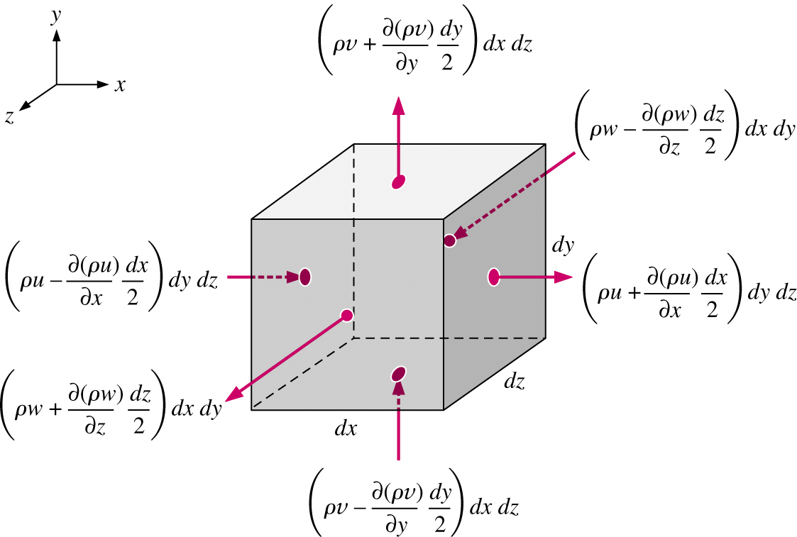
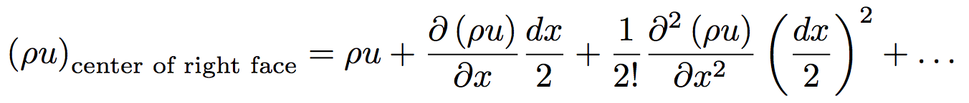
Conservation of Mass
Differential CV and Taylor series
First, define an infinitesimal control volume dx x dy x dz
Next, we approximate the mass flow rate into or out of each of the 6 faces using Taylor series expansions around the center point, e.g., at the right face
Ignore terms higher than order dx

Slide 10
Conservation of Mass
Differential CV and Taylor series
Infinitesimal control volume
of dimensions dx, dy, dz
Area of right
face = dy dz
Mass flow rate through
the right face of the
control volume

Slide 11
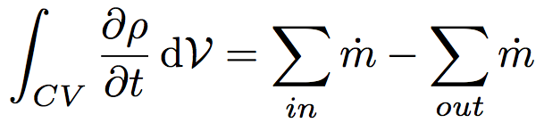
Conservation of Mass
Differential CV and Taylor series
Now, sum up the mass flow rates into and out of the 6 faces of the CV
Plug into integral conservation of mass equation
Net mass flow rate into CV:
Net mass flow rate out of CV:

Slide 12

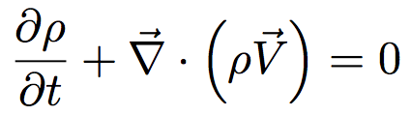
Conservation of Mass
Differential CV and Taylor series
After substitution,
Dividing through by volume dxdydz
Or, if we apply the definition of the divergence of a vector

Slide 13
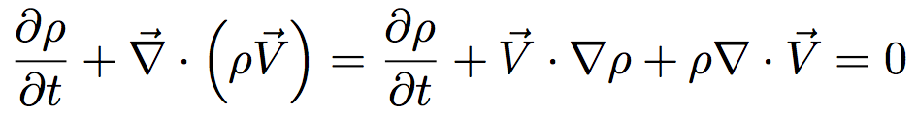
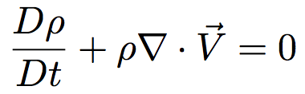
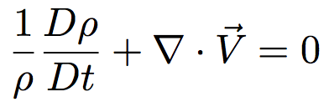
Conservation of Mass
Alternative form
Use product rule on divergence term

Slide 14
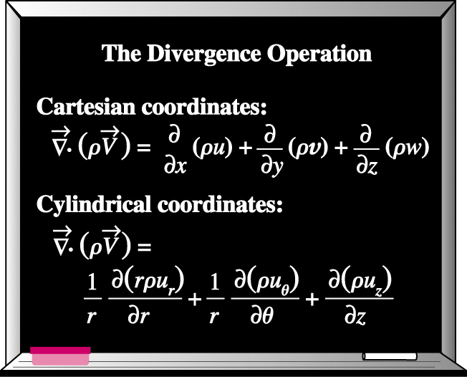
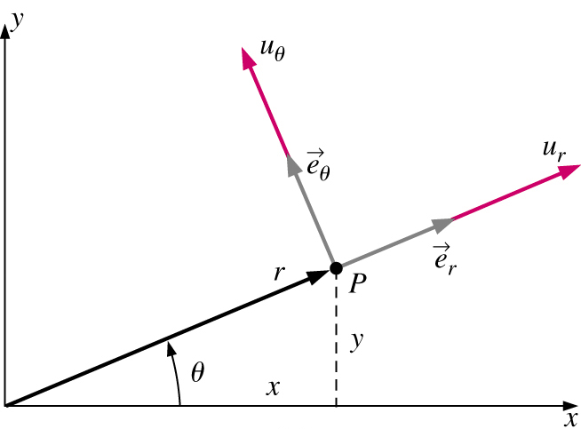
Conservation of Mass
Cylindrical coordinates
There are many problems which are simpler to solve if the equations are written in cylindrical-polar coordinates
Easiest way to convert from Cartesian is to use vector form and definition of divergence operator in cylindrical coordinates

Slide 15
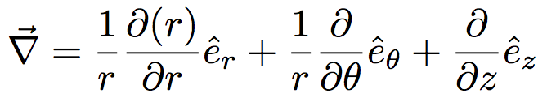

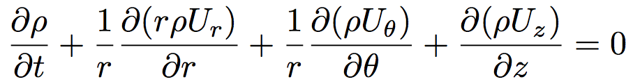
Conservation of Mass
Cylindrical coordinates

Slide 16

Conservation of Mass
Special Cases
Steady compressible flow
Cartesian
Cylindrical

Slide 17
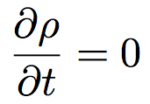


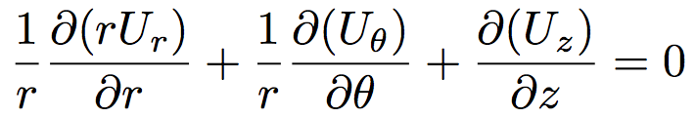
Conservation of Mass
Special Cases
Incompressible flow
and ρ = constant
Cartesian
Cylindrical

Slide 18
Conservation of Mass
In general, continuity equation cannot be used by itself to solve for flow field, however it can be used to
  Determine if velocity field is incompressible
  Find missing velocity component

Slide 19
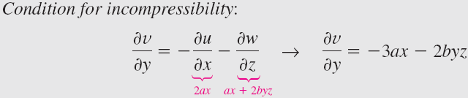
EXAMPLE 9–4: Finding a Missing Velocity Component
Two velocity components of a steady, incompressible, three-dimensional flow field are known, namely, u = ax² + by² + cz² and w = axz + byz², where a, b, and c are constants. The y velocity component is missing. Generate an expression for v as a function of x, y, and z.
Solution:
Therefore,

Slide 20



EXAMPLE 9–5: Two-Dimensional, Incompressible, Vortical Flow
Consider a two-dimensional, incompressible flow in cylindrical coordinates; the tangential velocity component is u_{θ} = K/r, where K is a constant. This represents a class of vortical flows. Generate an expression for the other velocity component, u_{r}.
Solution: The incompressible continuity equation for this two dimensional case simplifies to
⇒

Slide 21
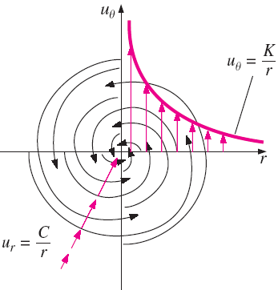
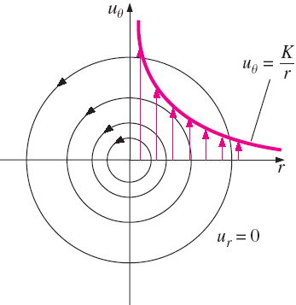
EXAMPLE 9–5: Two-Dimensional, Incompressible, Vortical Flow
A spiraling line vortex/sink flow
Line Vortex

Slide 22

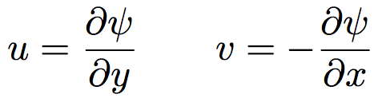
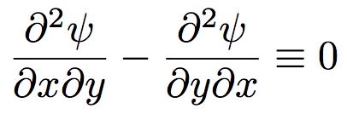
The Stream Function
Consider the continuity equation for an incompressible 2D flow
Substituting the clever transformation
Gives
This is true for any smooth
function ψ(x,y)

Slide 23
The Stream Function
Why do this?
  Single variable ψ replaces (u,v). Once ψ is known, (u,v) can be computed.
  Physical significance
    Curves of constant ψ are streamlines of the flow
    Difference in ψ between streamlines is equal to volume flow rate between streamlines
    The value of ψ increases to the left of the direction of flow in the xy-plane, “left-side convention.”

Slide 24
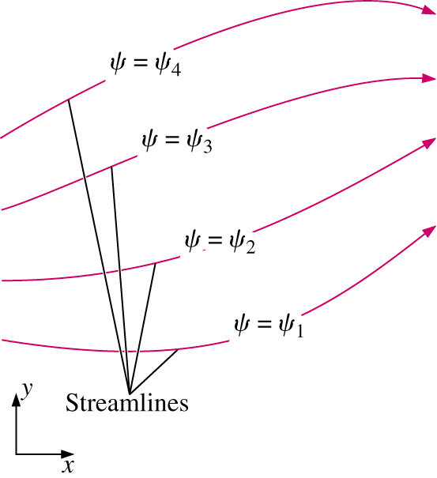
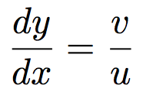

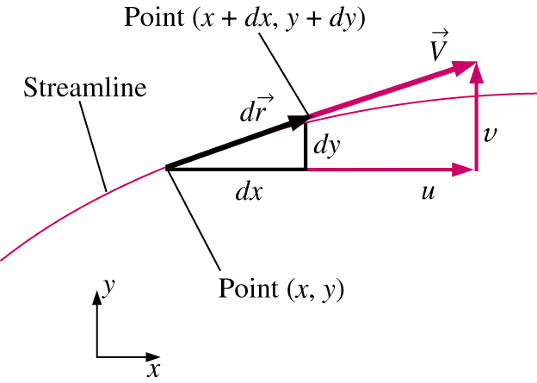
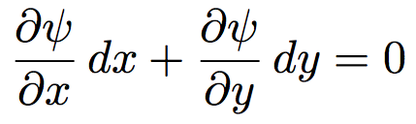

The Stream Function
Physical Significance
Recall from Chap. 4 that along a streamline
∴ Change in ψ along streamline is zero

Slide 25
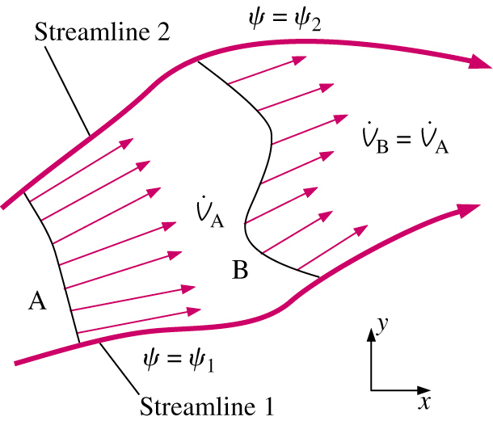

The Stream Function
Physical Significance
Difference in ψ between streamlines is equal to volume flow rate between streamlines (Proof on black board)

Slide 26
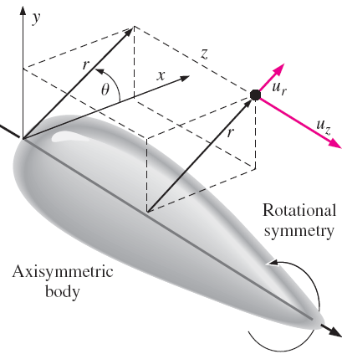



The Stream Function in Cylindrical Coordinates
Incompressible, planar stream function in cylindrical coordinates:
For incompressible axisymmetric flow, the continuity equation is
⇒

Slide 27
EXAMPLE 9–12 Stream Function in Cylindrical Coordinates
Consider a line vortex, defined as steady, planar, incompressible flow in which the velocity components are u_{r} = 0 and u_{θ} = K/r, where K is a constant. Derive an expression for the stream function ψ (r, θ), and prove that the streamlines are circles.
Line Vortex

Slide 28
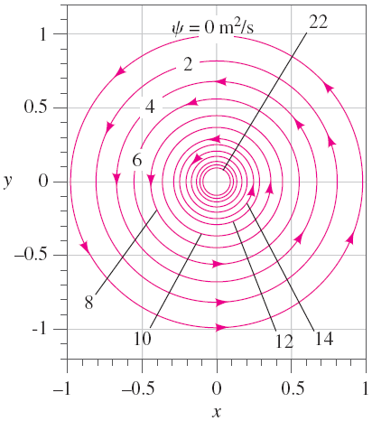



EXAMPLE 9–12 Stream Function in Cylindrical Coordinates
Solution:
⇒

Slide 29
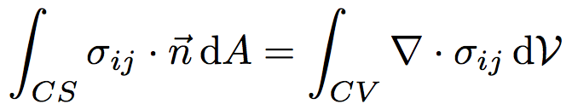
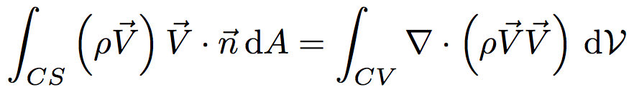
Conservation of Linear Momentum
Recall CV form from Chap. 6
Using the divergence theorem to convert area integrals
Body Force
Surface Force
σ_{ij} = stress tensor

Slide 30
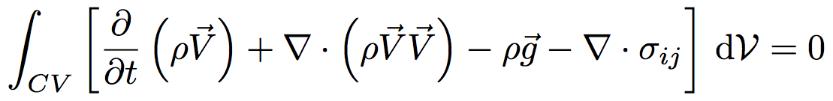
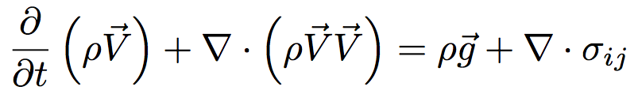
Conservation of Linear Momentum
Substituting volume integrals gives,
Recognizing that this holds for any CV, the integral may be dropped
This is Cauchy’s Equation
Can also be derived using infinitesimal CV and Newton’s 2nd Law (see text)

Slide 31
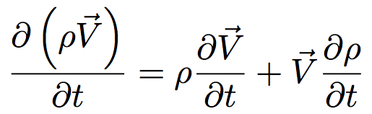
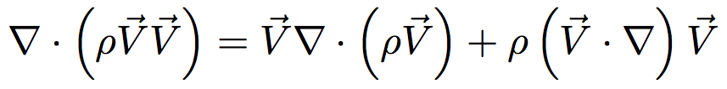
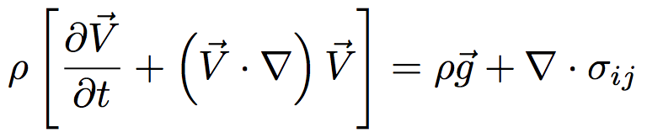
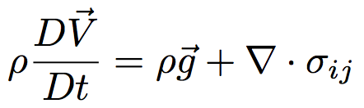
Conservation of Linear Momentum
Alternate form of the Cauchy Equation can be derived by introducing
Inserting these into Cauchy Equation and rearranging gives
(Chain Rule)

Slide 32
Conservation of Linear Momentum
Unfortunately, this equation is not very useful
  10 unknowns
    Stress tensor, σ_{ij} : 6 independent components
    Density ρ
    Velocity, V : 3 independent components
  4 equations (continuity + momentum)
  6 more equations required to close problem!

Slide 33
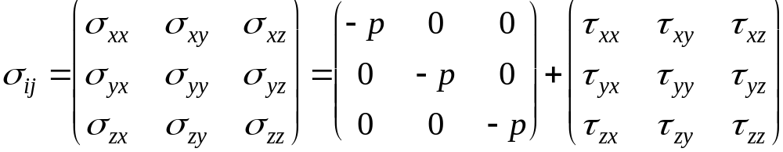
Navier-Stokes Equation
First step is to separate σ_{ij} into pressure and viscous stresses
Situation not yet improved
  6 unknowns in σ_{ij} ⇒ 6 unknowns in τ_{ij} + 1 in P, which means that we’ve added 1!
Viscous (Deviatoric)
Stress Tensor

Slide 34
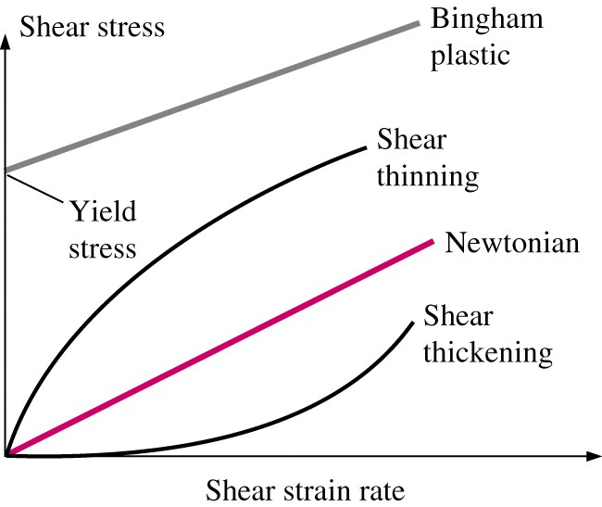

Navier-Stokes Equation
Reduction in the number of variables is achieved by relating shear stress to strain-rate tensor.
For Newtonian fluid with constant properties
(toothpaste)
(paint)
(quicksand)
Newtonian fluid includes most common
fluids: air, other gases, water, gasoline
Newtonian closure is analogous
to Hooke’s Law for elastic solids

Slide 35

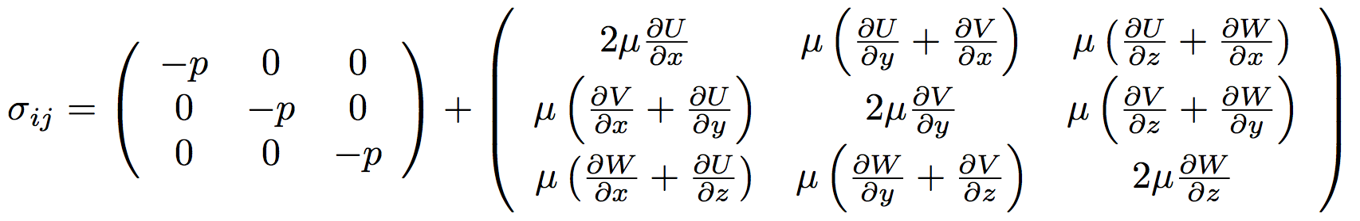
Navier-Stokes Equation
Substituting Newtonian closure into stress tensor gives
Using the definition of ε_{ij} (Chapter 4)
-

Slide 36
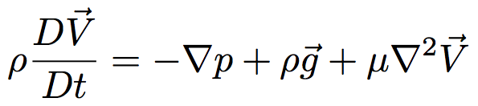
Navier-Stokes Equation
Substituting σ_{ij} into Cauchy’s equation gives the Navier-Stokes equations
This results in a closed system of equations!
  4 equations (continuity and momentum equations)
  4 unknowns (U, V, W, p)
Incompressible NSE
written in vector form

Slide 37
Navier-Stokes Equation
In addition to vector form, incompressible N-S equation can be written in several other forms
  Cartesian coordinates
  Cylindrical coordinates
  Tensor notation

Slide 38
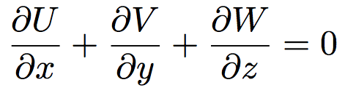
Navier-Stokes Equation
Cartesian Coordinates
Continuity
X-momentum
Y-momentum
Z-momentum
See page 431 for equations in cylindrical coordinates

Slide 39
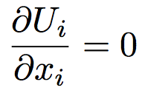
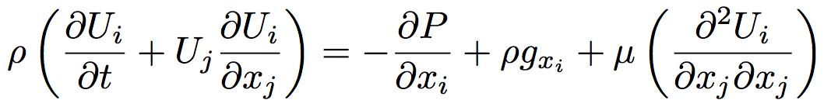
Navier-Stokes Equation
Tensor and Vector Notation
Tensor and Vector notation offer a more compact form of the equations.
Continuity
Tensor notation
Vector notation
Conservation of Momentum
Tensor notation
Vector notation
Repeated indices are summed over j
(x₁ = x, x₂ = y, x₃ = z, U₁ = U, U₂ = V, U₃ = W)

Slide 40
Differential Analysis of Fluid Flow Problems
Now that we have a set of governing partial differential equations, there are 2 problems we can solve
  Calculate pressure (P) for a known velocity field
  Calculate velocity (U, V, W) and pressure (P) for known geometry, boundary conditions (BC), and initial conditions (IC)

Slide 41
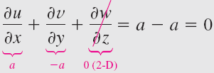

EXAMPLE 9–13 Calculating the Pressure Field in Cartesian Coordinates
Consider the steady, two-dimensional, incompressible velocity field, namely, . Calculate the pressure as a function of x and y.
Solution: Check continuity equation,
Consider the y-component of the Navier–Stokes equation:

Slide 42




EXAMPLE 9–13 Calculating the Pressure Field in Cartesian Coordinates
The y-momentum equation reduces to
In similar fashion, the x-momentum equation reduces to
Pressure field from y-momentum:
⇒

Slide 43


EXAMPLE 9–13 Calculating the Pressure Field in Cartesian Coordinates
Then we can get
Such that
Will the C₁ in the equation affect the velocity field? No. The velocity field in an incompressible flow is not affected by the absolute magnitude of pressure, but only by pressure differences.

Slide 44

EXAMPLE 9–13 Calculating the Pressure Field in Cartesian Coordinates
From the Navier-Stokes equation, we know the velocity field is affected by pressure gradient.
In order to determine that constant (C₁ in Example 9–13), we must measure (or otherwise obtain) P somewhere in the flow field. In other words, we require a pressure boundary condition. Please see the CFD results on the next page.

Slide 45


EXAMPLE 9–13 Calculating the Pressure Field in Cartesian Coordinates
Two cases are identical except for the pressure condition. The results of the velocity fields and streamline patterns confirm that the velocity field is affected by pressure gradient.

Slide 46

Exact Solutions of the NSE
There are about 80 known exact solutions to the NSE
The can be classified as:
  Linear solutions where the convective
  term is zero
  Nonlinear solutions where convective term is not zero
Solutions can also be classified by type or geometry
  Couette shear flows
  Steady duct/pipe flows
  Unsteady duct/pipe flows
  Flows with moving boundaries
  Similarity solutions
  Asymptotic suction flows
  Wind-driven Ekman flows

Slide 47
Exact Solutions of the NSE
Procedure for solving continuity and NSE
Set up the problem and geometry, identifying all relevant dimensions and parameters
List all appropriate assumptions, approximations, simplifications, and boundary conditions
Simplify the differential equations as much as possible
Integrate the equations
Apply BC to solve for constants of integration
Verify results

Slide 48
Boundary conditions
Boundary conditions are critical to exact, approximate, and computational solutions.
Discussed in Chapters 9 & 15
  BC’s used in analytical solutions are discussed here
    No-slip boundary condition
    Interface boundary condition
  These are used in CFD as well, plus there are some BC’s which arise due to specific issues in CFD modeling. These will be presented in Chap. 15.
    Inflow and outflow boundary conditions
    Symmetry and periodic boundary conditions

Slide 49




No-slip boundary condition
For a fluid in contact with a solid wall, the velocity of the fluid must equal that of the wall

Slide 50




Interface boundary condition
When two fluids meet at an interface, the velocity and shear stress must be the same on both sides
If surface tension effects are negligible and the surface is nearly flat

Slide 51




Interface boundary condition
Degenerate case of the interface BC occurs at the free surface of a liquid.
Same conditions hold
Since μ_{air} << μ_{water},
As with general interfaces, if surface tension effects are negligible and the surface is nearly flat P_{water} = P_{air}

Slide 52

Example exact solution (Ex. 9-15)
Fully Developed Couette Flow
For the given geometry and BC’s, calculate the velocity and pressure fields, and estimate the shear force per unit area acting on the bottom plate
Step 1: Geometry, dimensions, and properties

Slide 53

Example exact solution (Ex. 9-15)
Fully Developed Couette Flow
Step 2: Assumptions and BC’s
  Assumptions
    Plates are infinite in x and z
    Flow is steady, ∂/∂t = 0
    Parallel flow, V=0
    Incompressible, Newtonian, laminar, constant properties
    No pressure gradient
    2D, W=0, ∂/∂z = 0
    Gravity acts in the -z direction,
  Boundary conditions
    Bottom plate (y=0) : u=0, v=0, w=0
    Top plate (y=h) : u=V, v=0, w=0

Slide 54


Example exact solution (Ex. 9-15)
Fully Developed Couette Flow
Note: these numbers refer
to the assumptions on the
previous slide
Step 3: Simplify
3
6
Continuity
This means the flow is “fully developed”
or not changing in the direction of flow
X-momentum
2
Cont.
3
6
5
7
Cont.
6

Slide 55




Example exact solution (Ex. 9-15)
Fully Developed Couette Flow
Step 3: Simplify, cont.
Y-momentum
2,3
3
3
3,6
7
3
3
3
Z-momentum
2,6
6
6
6
6
6
6

Slide 56




Example exact solution (Ex. 9-15)
Fully Developed Couette Flow
Step 4: Integrate
X-momentum
integrate
integrate
Z-momentum
integrate

Slide 57



Example exact solution (Ex. 9-15)
Fully Developed Couette Flow
Step 5: Apply BC’s
  y=0, u=0=C₁(0) + C₂ ⇒ C₂ = 0
  y=h, u=V=C₁h ⇒ C₁ = V/h
  This gives
  For pressure, no explicit BC, therefore C₃ can remain an arbitrary constant (recall only ∇P appears in NSE).
    Let p = p₀ at z = 0 (C₃ renamed p₀)
Hydrostatic pressure
Pressure acts independently of flow

Slide 58


Example exact solution (Ex. 9-15)
Fully Developed Couette Flow
Step 6: Verify solution by back-substituting into differential equations
  Given the solution (u,v,w)=(Vy/h, 0, 0)
  Continuity is satisfied
    0 + 0 + 0 = 0
  X-momentum is satisfied

Slide 59




Example exact solution (Ex. 9-15)
Fully Developed Couette Flow
Finally, calculate shear force on bottom plate
Shear force per unit area acting on the wall
Note that τ_{w} is equal and opposite to the
shear stress acting on the fluid τ_{yx}
(Newton’s third law).

Slide 60

Rotational viscometer
An instrument used to measure viscosity. is constructed of two concentric circular cylinders of length L— a solid, rotating inner cylinder of radius R_{i} and a hollow, stationary outer cylinder of radius R_{o}.
The gap is small, i.e. (R_{o} - R_{i}) << R_{o}.
Find the viscosity of the fluid in between the cylinders.

Slide 61



Rotational viscometer
The viscous shear stress acting on a fluid element adjacent to the inner cylinder is approximately equal to
The total clockwise torque acting on the inner cylinder wall due to fluid viscosity is
Under steady conditions, the clockwise torque T_{viscous} is balanced by the applied counterclockwise torque T_{applied}.
Therefore, viscosity of the fluid:

Slide 62


EXAMPLE 9–16 Couette Flow with an Applied Pressure Gradient
The detailed derivation is referred to pages 443 -446 in the text.

Slide 63

EXAMPLE 9–17 Oil Film Flowing Down a Vertical Wall by Gravity
Consider steady, incompressible, parallel, laminar flow of a film of oil falling slowly down an infinite vertical wall. The oil film thickness is h, and gravity acts in the negative z-direction. There is no applied (forced) pressure driving the flow—the oil falls by gravity alone. Calculate the velocity and pressure fields in the oil film and sketch the normalized velocity profile. You may neglect changes in the hydrostatic pressure of the surrounding air.

Slide 64
EXAMPLE 9–17 Oil Film Flowing Down a Vertical Wall by Gravity
Solution:
  Assumptions
    Plates are infinite in y and z
    Flow is steady, ∂/∂t = 0
    Parallel flow, u=0
    Incompressible, Newtonian, laminar, constant properties
    P=P_{atm} = constant at free surface and no pressure gradient
    2D, v=0, ∂/∂y = 0
    Gravity acts in the -z direction,
  Boundary conditions
    No slip at wall (x=0) : u=0, v=0, w=0
    At the free surface (x = h), there is negligible shear, means ∂w/∂x = 0 at x = h.

Slide 65

EXAMPLE 9–17 Oil Film Flowing Down a Vertical Wall by Gravity
Step 3: Write out and simplify the differential equations.
Therefore,
Since u = v = 0 everywhere, and gravity does not act in the x- or y-directions, the x- and y-momentum equations are satisfied exactly (in fact all terms are zero in both equations). The z-momentum equation reduces to

Slide 66



EXAMPLE 9–17 Oil Film Flowing Down a Vertical Wall by Gravity
Step 4 Solve the differential equations. (Integrating twice)

Slide 67


EXAMPLE 9–17 Oil Film Flowing Down a Vertical Wall by Gravity
Step 5 Apply boundary conditions.
Velocity field:
Since x < h in the film, w is negative everywhere, as expected (flow is downward). The pressure field is trivial; namely, P = P_{atm} everywhere.

Slide 68


EXAMPLE 9–17 Oil Film Flowing Down a Vertical Wall by Gravity
Step 6 Verify the results.

Slide 69


EXAMPLE 9–18 Fully Developed Flow in a Round Pipe — Poiseuille Flow
Consider steady, incompressible, laminar flow of a Newtonian fluid in an infinitely long round pipe of radius R = D/2. We ignore the effects of gravity. A constant pressure gradient P/x is applied in the x-direction,
where x₁ and x₂ are two arbitrary locations along the x-axis, and P₁ and P₂ are the pressures at those two locations.

Slide 70
EXAMPLE 9–18 Fully Developed Flow in a Round Pipe — Poiseuille Flow
Derive an expression for the velocity field inside the pipe and estimate the viscous shear force per unit surface area acting on the pipe wall.
Solution:
  Assumptions
    1. The pipe is infinitely long in the x-direction.
    2. Flow is steady, ∂/∂t = 0
    3. Parallel flow, u_{r} = zero.
    4. Incompressible, Newtonian, laminar, constant properties
    5. A constant-pressure gradient is applied in the x-direction
    6. The velocity field is axisymmetric with no swirl, implying that u_{θ} = 0 and all partial derivatives with respect to θ are zero.
    7. ignore the effects of gravity.

Slide 71


EXAMPLE 9–18 Fully Developed Flow in a Round Pipe — Poiseuille Flow
Solution:
  Step 2 List boundary conditions.
  at r = R,
  (2) at r = 0, du/dr = 0.
  Step 3 Write out and simplify the differential equations.

Slide 72



EXAMPLE 9–18 Fully Developed Flow in a Round Pipe — Poiseuille Flow
Solution:
We now simplify the axial momentum equation
Or

Slide 73



EXAMPLE 9–18 Fully Developed Flow in a Round Pipe — Poiseuille Flow
Solution:
In similar fashion, every term in the r-momentum equation
Finally, all terms of the θ-component of the Navier–Stokes equation go to zero.
Step 4 Solve the differential equations.
After multiplying both sides of Equation (4) by r, we integrate once to obtain

Slide 74




EXAMPLE 9–18 Fully Developed Flow in a Round Pipe — Poiseuille Flow
Solution:
Dividing both sides of Eq. 7 by r, we integrate again to get
Step 5 Apply boundary conditions.

Slide 75


EXAMPLE 9–18 Fully Developed Flow in a Round Pipe — Poiseuille Flow
Solution:
Finally, the result becomes
Step 6 Verify the results. You can verify that all the differential equations and boundary conditions are satisfied.

